Slide 1
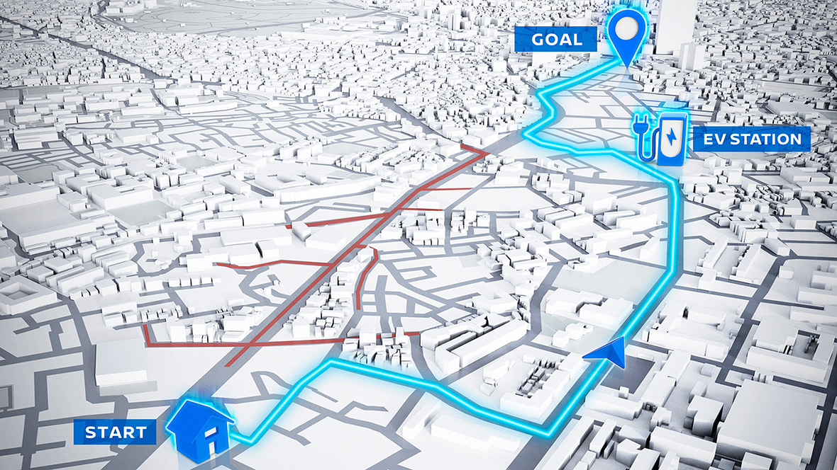
Electric vehicle route planner
Guangyao Li | Jiajun Liu | Changsheng Tian

Slide 2

Background
Introduction to Electric Vehicle (EV) Adoption
Increasing adoption of electric vehicles presents new challenges.
EVs require careful planning due to limited range and reliance on charging infrastructure.
Challenges Faced by EV Drivers
Range anxiety: Fear of insufficient charge to reach the destination.
Need for reliable charging infrastructure.
Notes:
The growing adoption of electric vehicles (EVs) presents both opportunities and challenges in the realm of route planning and navigation. Unlike traditional internal combustion engine vehicles, EVs require careful planning due to their limited range and reliance on charging infrastructure. This unique requirement has led to the development of the Electric Vehicle Route Planner (EVRP), a tool designed to address these challenges and enhance the EV driving experience.
A significant concern for EV drivers is range anxiety, the fear that a vehicle does not have enough charge to reach its destination. This anxiety is a major barrier to the widespread adoption of electric vehicles. The EVRP aims to alleviate range anxiety by ensuring that drivers are well-informed about optimal routes and essential charging stops, making long-distance travel more feasible and stress-free.

Slide 3
Purpose
1. Mitigating Range Anxiety
2. Optimizing Travel Time and Efficiency
3. Enhancing User Experience
4. Giving Professional Advice
Notes:
1. Mitigating Range Anxiety
Range anxiety is a major concern for EV drivers, referring to the fear that their vehicle may not have enough charge to reach the destination. This anxiety can deter potential buyers from choosing electric vehicles. The EVRP aims to mitigate this anxiety by ensuring drivers are aware of optimal routes and necessary charging stops, providing peace of mind and making EVs a more attractive option.
2. Optimizing Travel Time and Efficiency
One of the key purposes of the EVRP is to minimize overall travel time while ensuring that the vehicle can complete its journey without running out of charge. This involves calculating the most efficient routes and strategically planning charging stops based on the vehicle’s range and the availability of charging infrastructure. The planner seeks to integrate charging stops into the travel itinerary in a way that causes minimal deviation from the optimal path.
3. Enhancing User Experience
The EVRP is designed to provide a user-friendly interface that allows drivers to easily input their starting and ending points, vehicle specifications, and other preferences. By displaying the calculated route along with charging stops on a map, the EVRP offers a clear and actionable travel plan. This enhances the overall user experience, making long-distance travel more feasible and less stressful for EV drivers.

Slide 4
Role
Name | Role
Changsheng Tian | Algorithm developer
Jiajun Liu | Front-end and Back-end developer
Guangyao Li | Back-end developer & Project Architecture

Slide 5
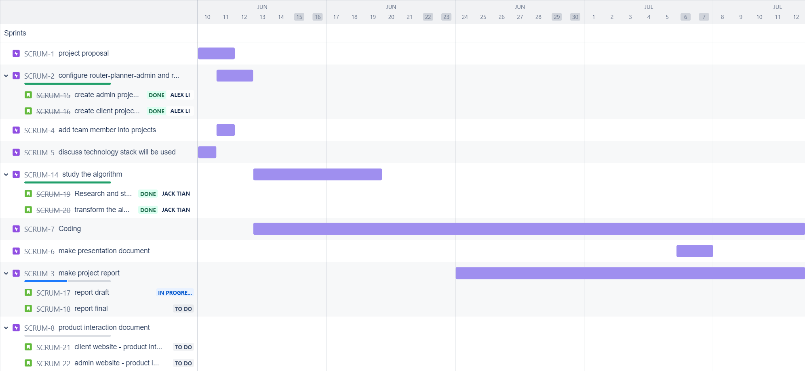
Timeline

Slide 6
Algorithm
Hybrid Algorithm(Dynamic Programming + Greedy)
1. Initial Check and Route Autonomy Calculation
‘thisRoutesAutonomyDistanceRatio >= 1’
2. Determining the Number of Stops
‘numberOfStops = Math.ceil(1 / thisRoutesAutonomyDistanceRatio) - 1’
3. Calculating Segment Distances and Stop Points
‘calculateDistancesFromRouteCoordinates(thisRoute)’
‘getStopCircleCenterPoints(thisRoute, segmentDistances)’
4. Finding Charging Stations
‘getChargerData(urlForApiRequestArg))’
‘distancesFromStopPoint.indexOf(Math.min(...distancesFromStopPoint)))’
5. Validation and Iteration
Notes:
focusing on identifying optimal charging stops along a planned route. Here's a detailed explanation of how the algorithm works:
Initial Check and Route Autonomy Calculation:
The algorithm starts by checking if the vehicle can complete the route without needing to charge. This is done by comparing the ratio of the route distance to the vehicle's autonomy (maximum distance the vehicle can travel on a full charge).
If the vehicle can complete the route (thisRoutesAutonomyDistanceRatio >= 1), an itinerary is found and the process returns with a success flag and no charging stops.
Determining the Number of Stops:
If the vehicle cannot complete the route on a single charge, the algorithm calculates the number of necessary charging stops. This is done by taking the ceiling of the inverse of the autonomy-distance ratio, subtracting one (numberOfStops = Math.ceil(1 / thisRoutesAutonomyDistanceRatio) - 1).
Calculating Segment Distances and Stop Points:
The route is divided into segments, and the distance of each segment is calculated (calculateDistancesFromRouteCoordinates(thisRoute)).
Based on these segment distances, the algorithm identifies potential stop points where charging stations might be needed (getStopCircleCenterPoints(thisRoute, segmentDistances)).
Finding Charging Stations:
For each stop point, the algorithm searches for charging stations within a specified radius. This radius starts at a minimum value and increases if no charging stations are found.
The search for charging stations is done using an external API, which returns data on nearby charging stations (getChargerData(urlForApiRequestArg)).
If charging stations are found, the closest one to the stop point is selected (distancesFromStopPoint.indexOf(Math.min(...distancesFromStopPoint))).
Validation and Iteration:
The algorithm ensures that the number of charging stations found matches the number of required stops.
If the required number of charging stations are found, the itinerary is considered successful and the final data on charging stops is returned. Otherwise, the search radius is increased and the process is repeated.
Key Functions Explained
calculateDistancesFromRouteCoordinates:
This function calculates the distances between consecutive coordinates on the route using the Haversine formula, which provides the great-circle distance between two points on a sphere given their longitudes and latitudes.
getStopCircleCenterPoints:
This function determines the central points of potential charging stops along the route based on the vehicle's autonomy and segment distances.
obtainChargersForThisRoute:
This function performs the actual search for charging stations. It incrementally increases the search radius until a suitable charging station is found for each stop point.
getDistanceFromLatLonInKm:
This utility function calculates the distance between two geographic coordinates using the Haversine formula.
buildURL:
This function constructs the URL for the API request to search for charging stations near a given stop point within a specified radius.

Slide 7
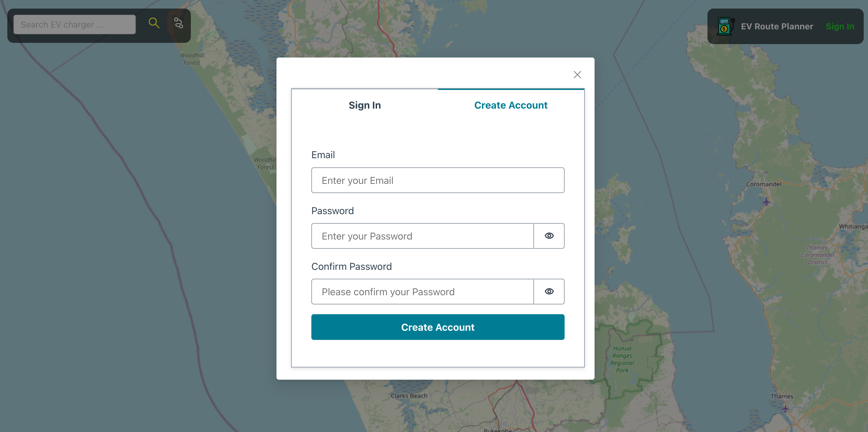
Create the account

Slide 8
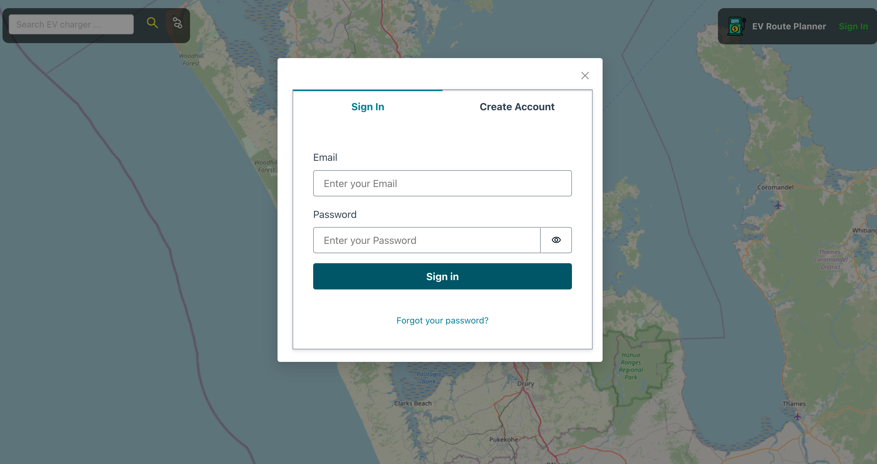
Sign-in

Slide 9
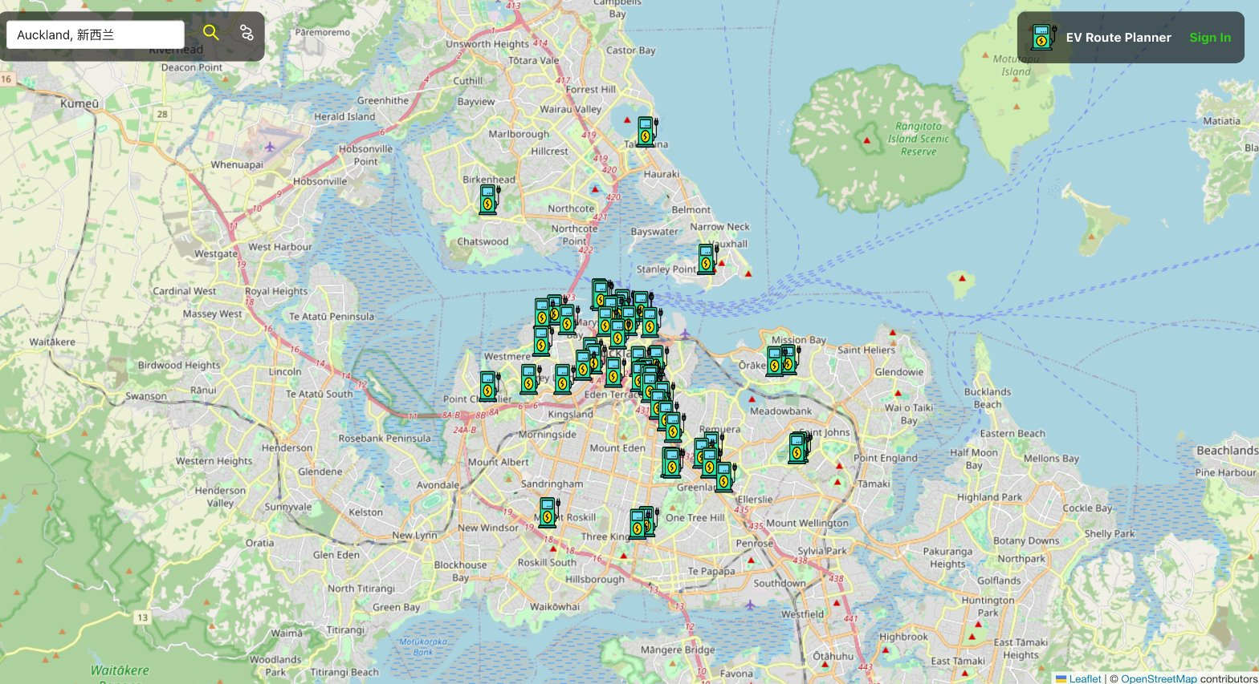
Search Charging Stations

Slide 10
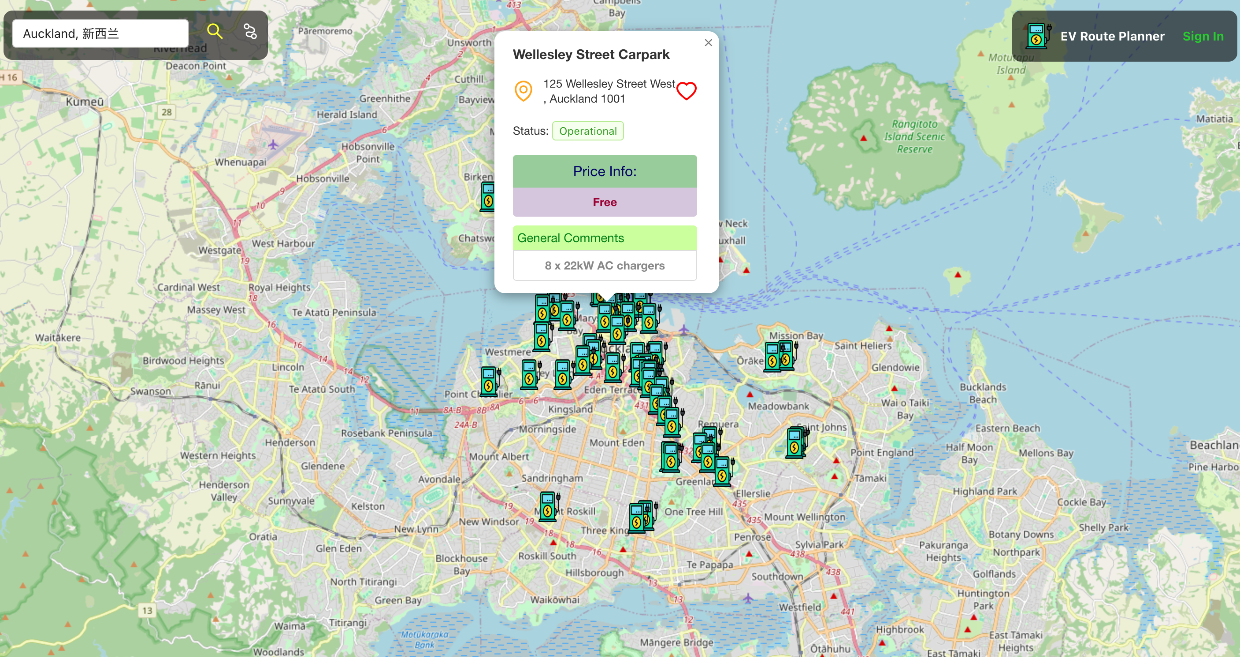
Charging Station Information

Slide 11
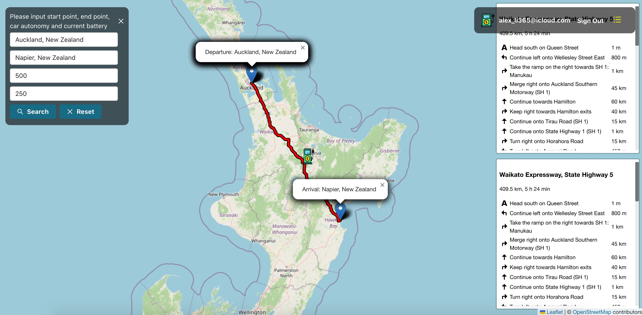
Route Planning

Slide 12
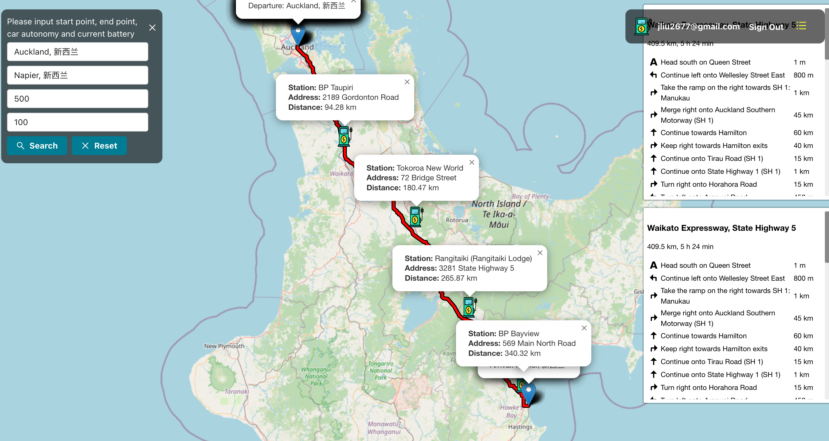
Route Planning Continued

Slide 13
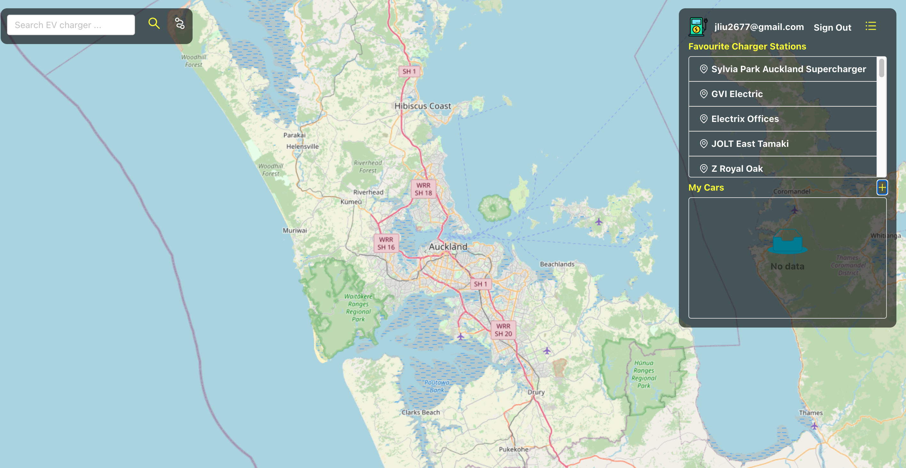
User Dashboard

Slide 14
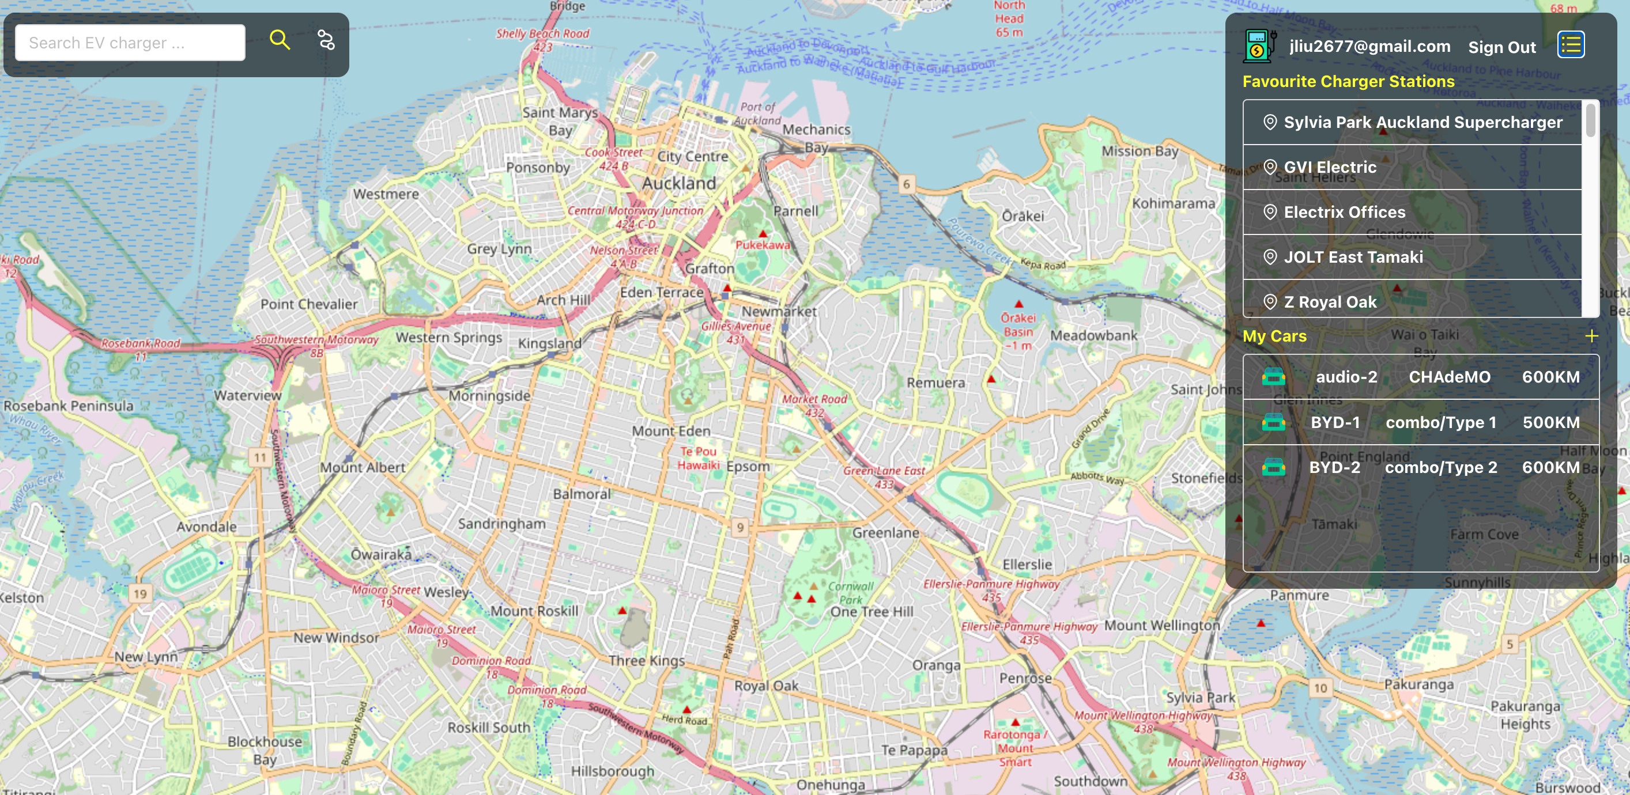
User Dashboard Continued

Slide 15
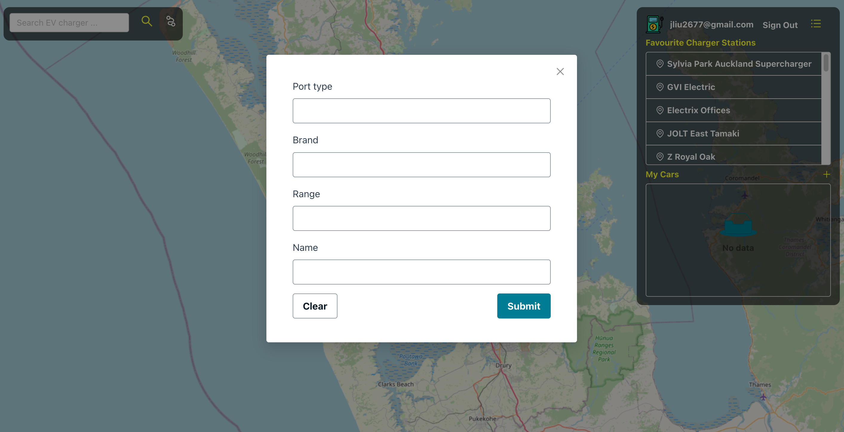
Add Car

Slide 16
ITS implementation
This website can be used around the world, not just restricted to NZ
OpenStreetMap API with Leaflet Library
OpenCharging API
Energy Consumption Optimization
Notes:
OpenStreetMap API with Leaflet Library: It is used to identify the latitude and longitude of departure address and destination and spot the address on the map.
Route plan is generated by the OpenStreetMap API with Leaflet Library, then, the range EV can cover will be calculated based on current battery situation and car autonomy. Then, if the range EV can cover can not reach to the destination. The charging stations within the range EVs can cover will be shown to users. For example, the range the EV can cover is 30 kilometer, and it can not support the EVs to arrive at the destination. Charging stations within the 30 kilometers will be shown to users.
OpenCharging API: It is used to get and identify the charging station location and information about it, like address, status, price, and comments.
Energy Consumption Optimization: EV route planning provides the optimized route with optimized energy consumption to save the energy cost and reduce the impact of energy consumption on the environment

Slide 17
Future Improvement
Collaborate with companies of charging stations
Integrate with the real-time traffic flow to avoid some traffic congestion
User Feedback mechanism
Customer can input the electricity amount charged
Notes:
Colloborate with companies of charging stations to get real-time availability of charging ports from their open API
Integrate with the real-time traffic flow OpenAPI to identify potential traffic jam and generate the route to avoid traffic congestion with less commuting time
Generate the user feedback mechanism to get feedback about the user experience and any suggestions for improvements to better satisfy the users' needs.

Slide 18
EV Route Planner Admin
The data of Search Locations
The data of Clicks of EV Charger
Research
Method
The data of User’s Cars(EVs)
The data of User's Favourte EV Chargers
Target
Analysis these real-time data to
give some recommendations

Slide 19
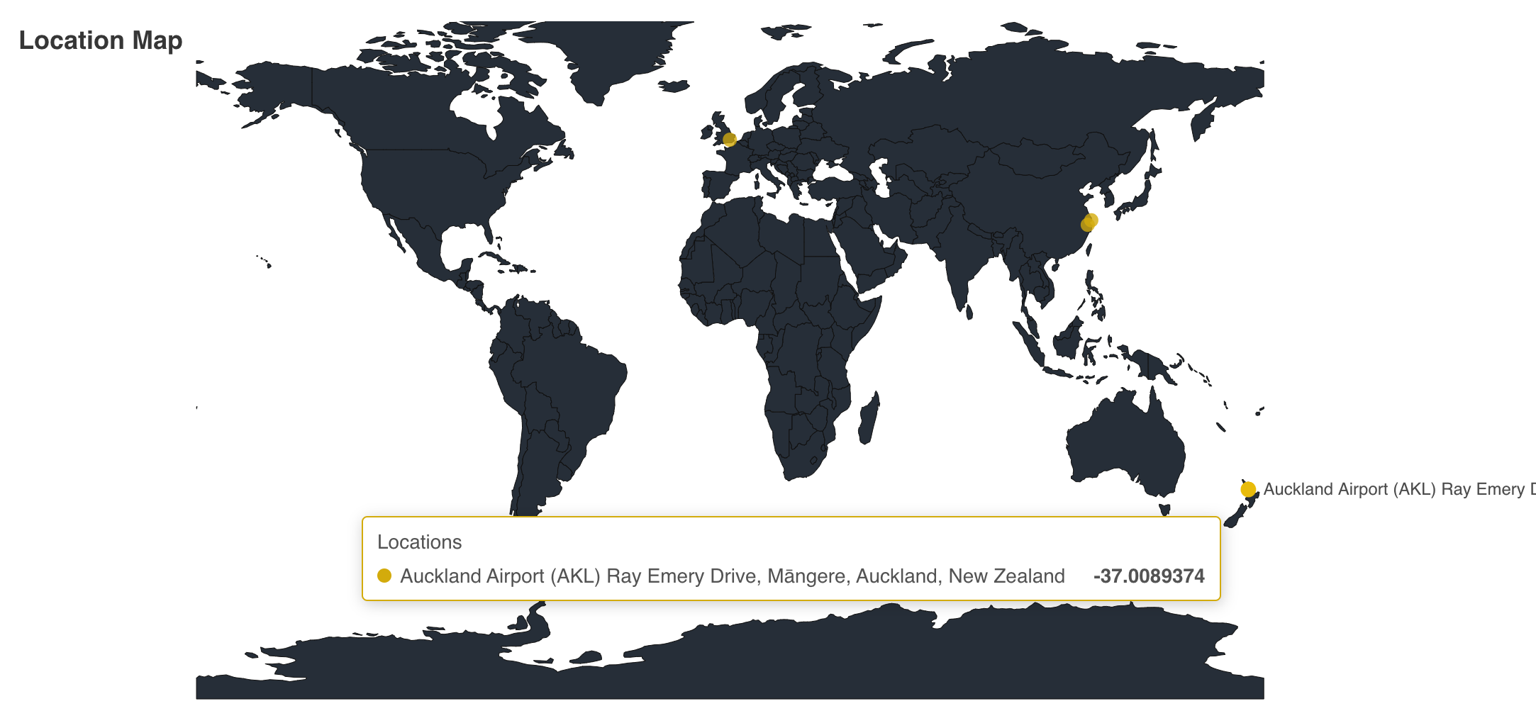
EV Route Planner Admin
Data Analysis from Search Locations

Slide 20
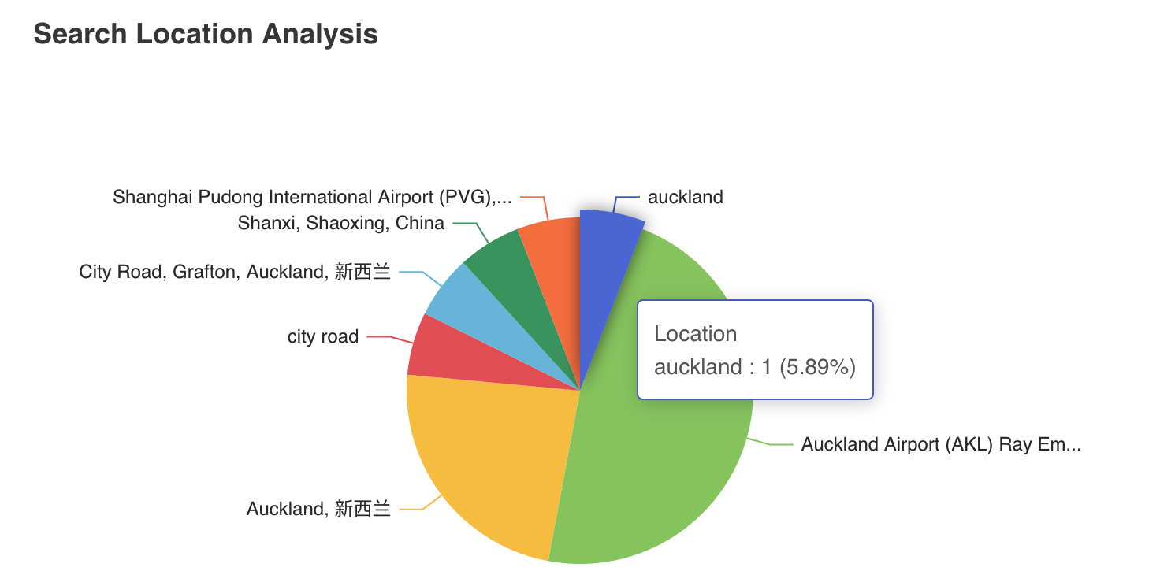
EV Route Planner Admin
Data Analysis from Search Locations

Slide 21
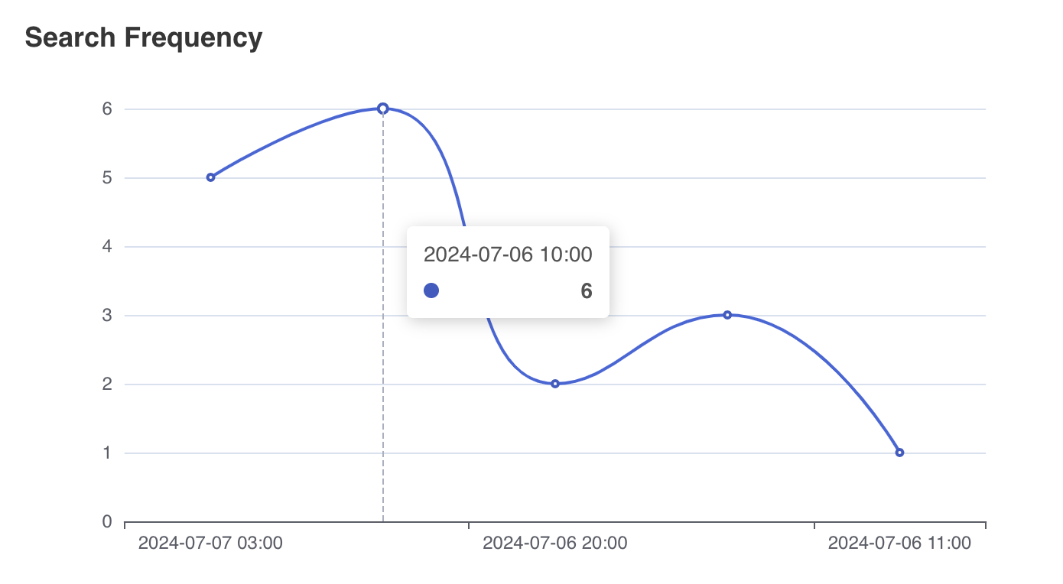
EV Route Planner Admin
Data Analysis from Search Locations

Slide 22
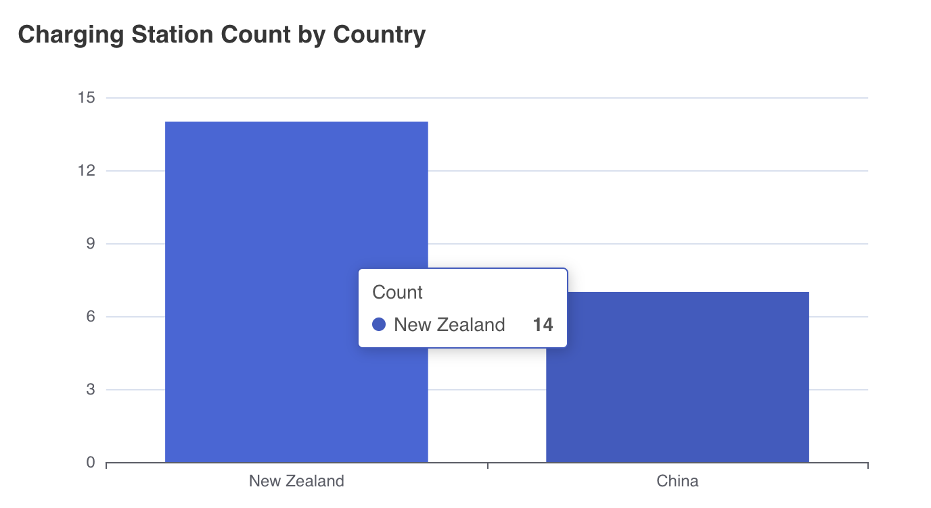
EV Route Planner Admin
Data Analysis from Clicks of EV Charger

Slide 23
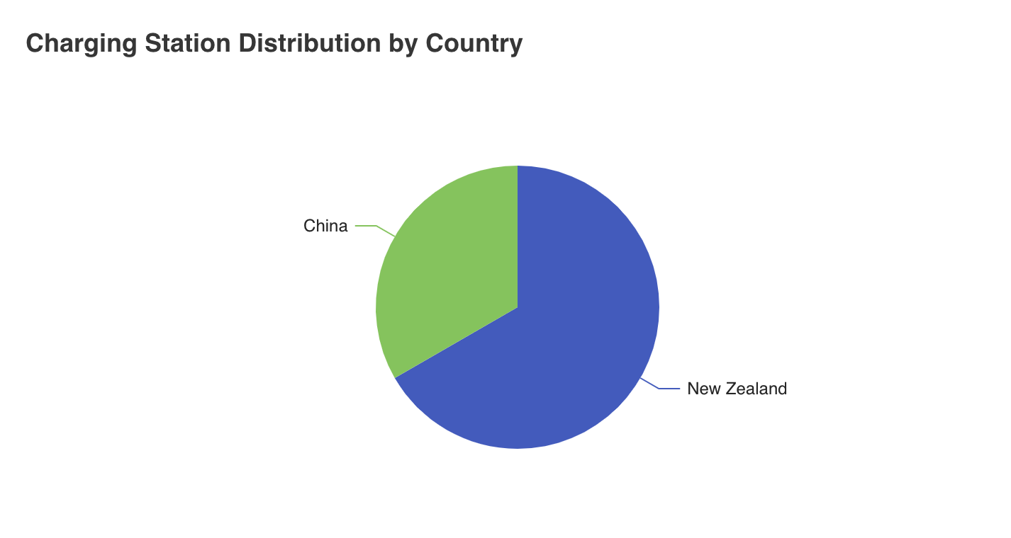
EV Route Planner Admin
Data Analysis from Clicks of EV Charger

Slide 24
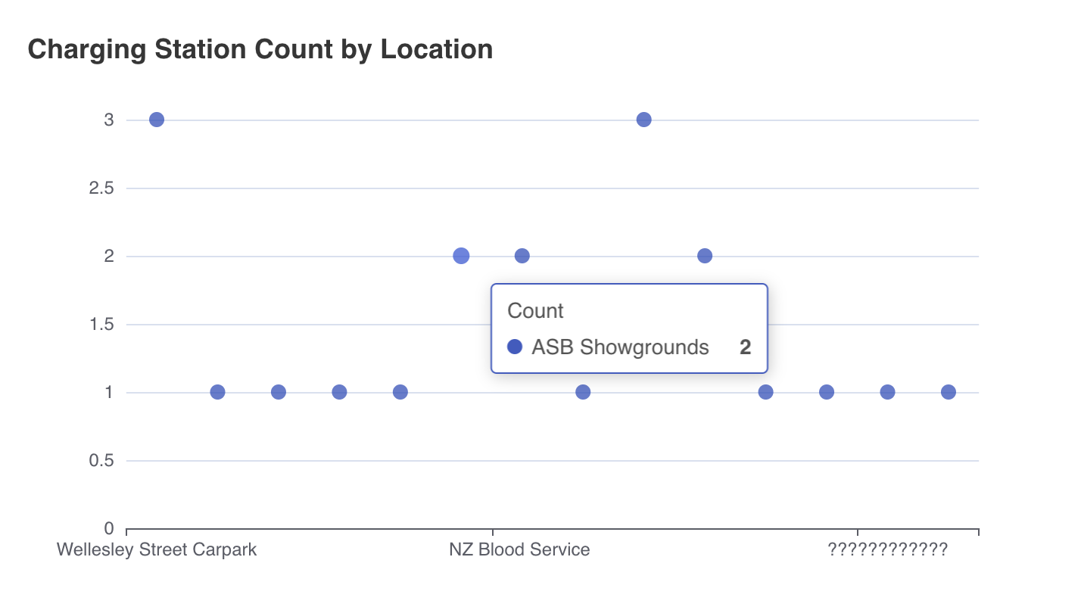
EV Route Planner Admin
Data Analysis from Clicks of EV Charger

Slide 25
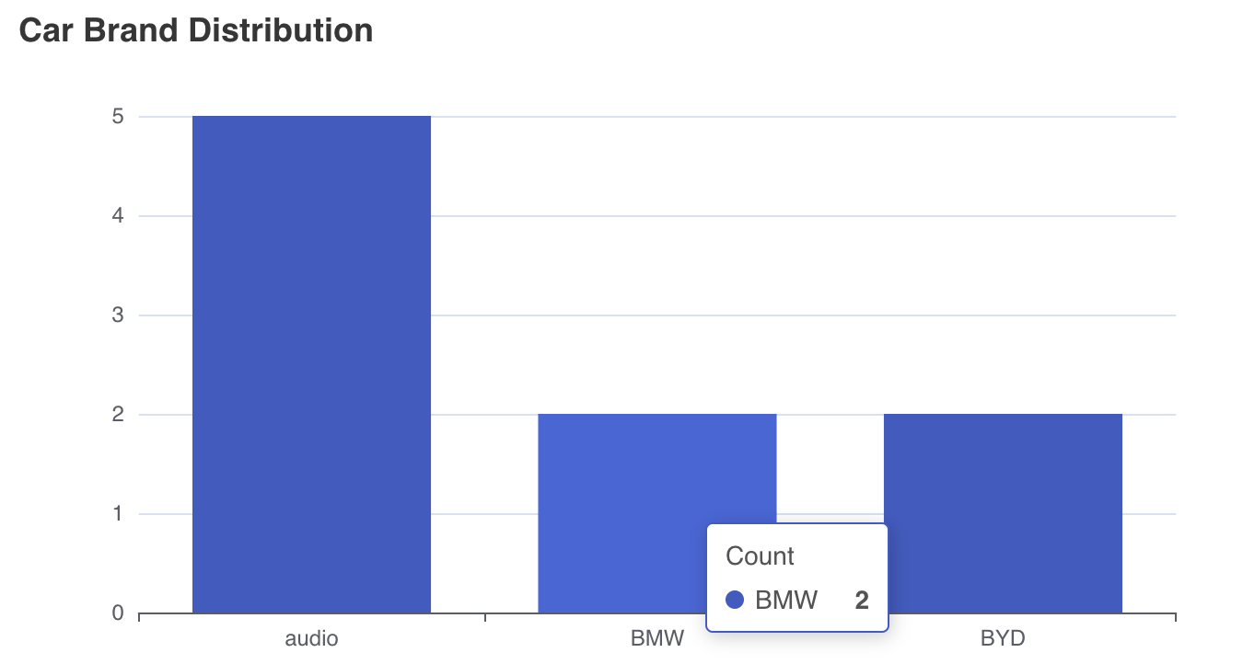
EV Route Planner Admin
Data Analysis from EVs

Slide 26
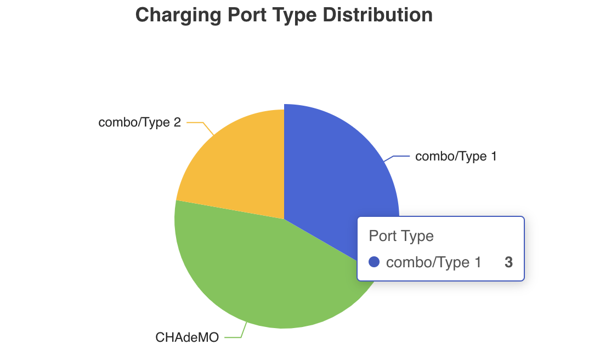
EV Route Planner Admin
Data Analysis from EVs

Slide 27
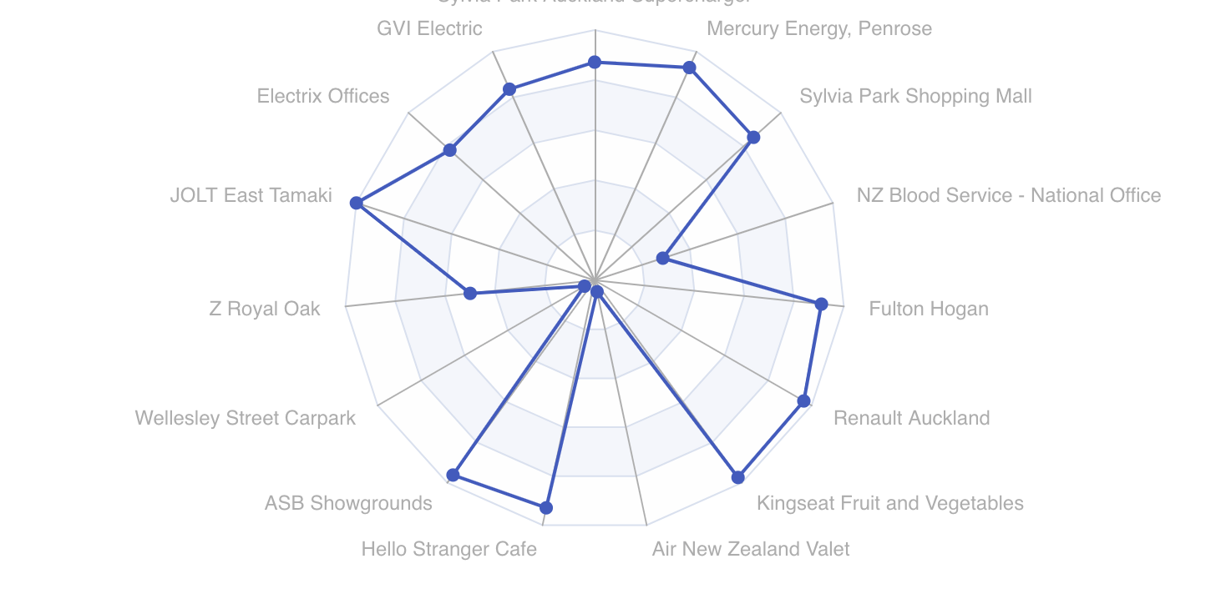
EV Route Planner Admin
Data Analysis from User's Favourite EV Chargers

Slide 28
Architecture
Project Mode - frontend and backend separation
Client
Interaction
API & Database
Interaction
Admin
Provide
AWS
Openchargemap API
Openstreetmap API

Slide 29
Database & Security
Amazon Cognito
Manages user sign-up, sign-in, and access control.
Amazon DynamoDB
NoSQL database for high performance and scalability.

Slide 30
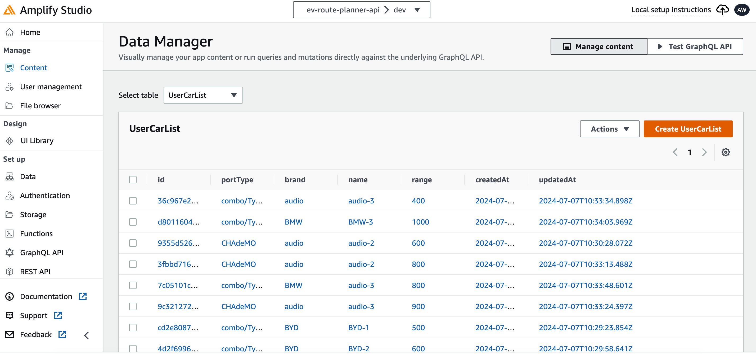
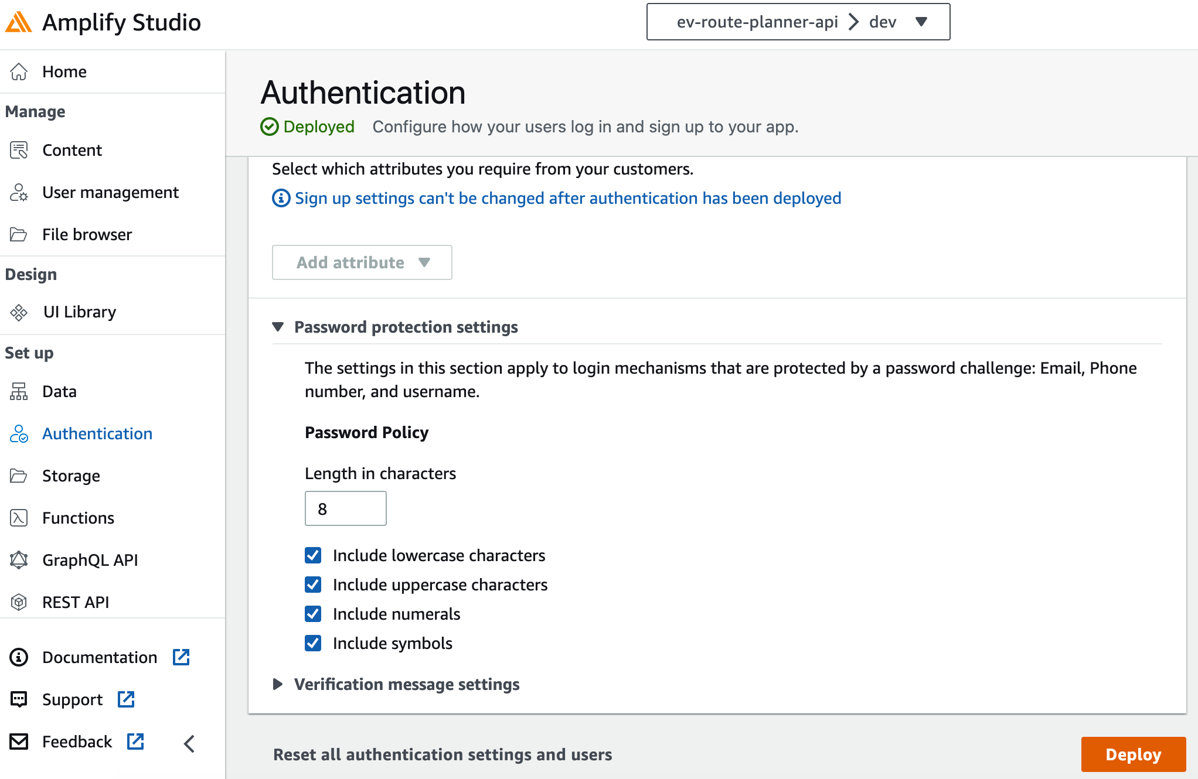
Database – Amplify Studio

Slide 31
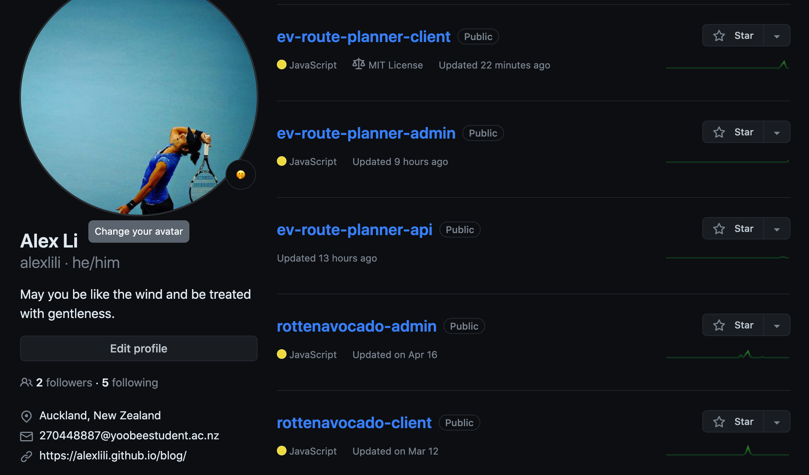
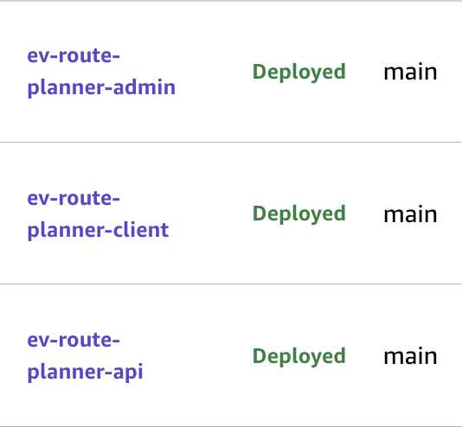
Project Setting
Bind
Bind
Bind
AWS-Amplify

Slide 32
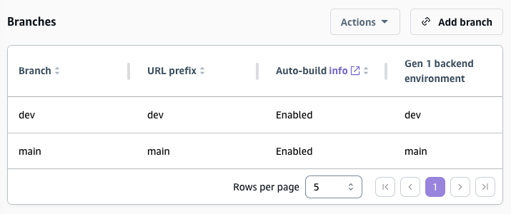
Development Environment
Github Project
Dev
For development
Client
API
Admin
Deploy
AWS Amplify
Main
For production
Example

Slide 33
Repositories & Website-dev
Repositories
Website-dev
https://github.com/alexlili/ev-route-planner-client
https://dev.d1pghmqcjpsb6.amplifyapp.com/
https://github.com/alexlili/ev-route-planner-admin
https://dev.d2uxghi9675sr8.amplifyapp.com/
https://github.com/alexlili/ev-route-planner-api

